Slide 1
“Tools and criteria for URBAN groundWATer management” (URBANWAT)
Carlos Ayora Ibáñez
Water JPI 2018 Joint Call 12 April 2019, Stockholm

Slide 2
OBJECTIVES
URBANWAT project aims to work on:
detection of pollutants in urban waters
study potential water filtering in urbanized settings
develop ultrasensitive tracing technology for water flow paths assessment
calibrate an urban GW model (modelling the ‘urban’ water cycle) for city scale water management.
URBANWAT project proposes two complimentary scales of research:
THEORY AND LAB SCALE: URBANWAT makes use of a full-scale testing and demonstration facility called ‘WaterStreet’ at TUDelft.
REAL CITY SCALE: Barcelona as pilot city. The quality of BARCELONA aquifers has deteriorated due to several sources of pollutants both organic and inorganic. In recent years, the urban area of Barcelona is betting on improving groundwater management with the aim of increasing groundwater uses.
Countries: SPAIN, FRANCE, NETHERLANDS

Slide 3
CONSORTIUM DESCRIPTION
1. Spanish Research Council (CSIC) (SPAIN) Role: CSIC, leader of the project,
It is formed by Groundwater and Hydrogeochemistry and Environmental Chemistry Groups.
Expertise:
Hydrogeochemistry, groundwater management, numerical modelling
Development of multiple methodologies for the analysis of emerging contaminants.
Evaluation of ecotoxicological risk

Slide 4
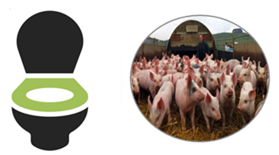
CONSORTIUM DESCRIPTION
2. Laboratory of Viruses Contaminant of Water and Food, University of Barcelona (Spain).
Expertise:
Evaluation the presence of viral pathogens, also emergent ones, in water and food
Evaluation the Risk for exposed humans.
Microbiological sampling and analyses of groundwater using new methodologies.

Slide 5
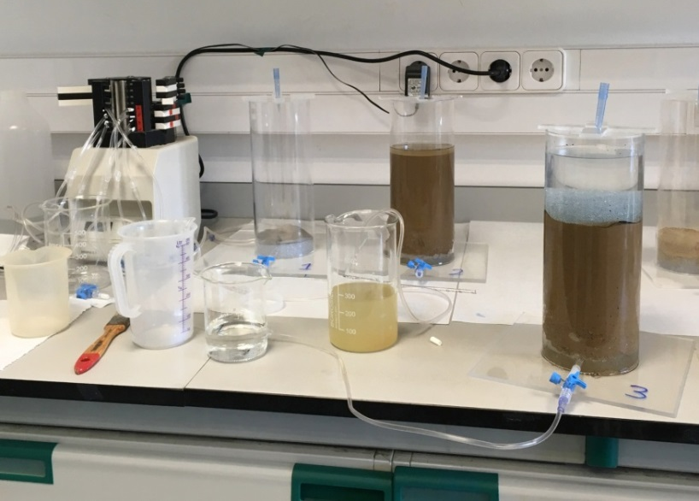
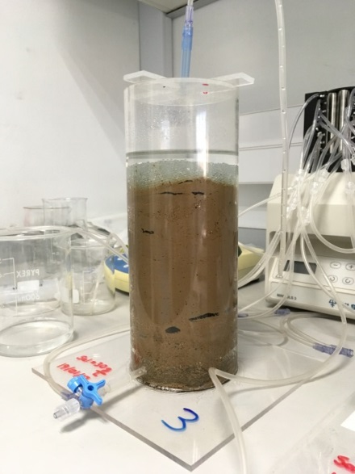
CONSORTIUM DESCRIPTION
3. Centre National de la Recherche Scientifique (France) (CNRS).
Expertise:
Quantifying and predicting how the climate change and increase of human activities affect water resources.
Proposal of the remediation methods to reduce the runoff water contamination.

Slide 6
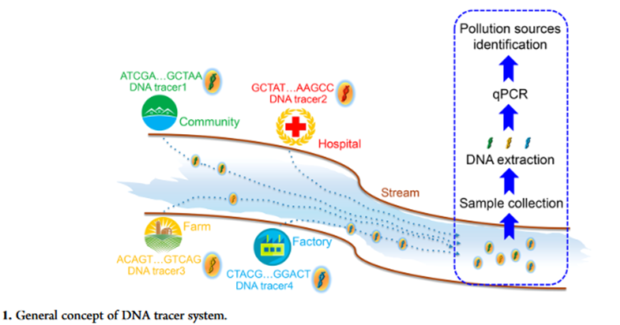
CONSORTIUM DESCRIPTION
4. Department of Water management of Delft University of Technology (Netherlands) (TUD).
Expertise:
Innovative hydrological measurement and monitoring techniques (DNA, DNA-tagged micro-particles)
Quantification of preferential flow paths in soil hydrology and groundwater recharge.
Full-scale experimental facility called “WaterStreet”, show-case for urban water management.
Main responsibilities
Characterization and functionalisation of nanoparticles
Transport characterisation in porous media and surface water
Organization of experiment in Open-Air Lab WaterSTreet, a full-scale testing and demonstration facility at TUDelft campus
General concept of DNA tracer system
Netherlands
http://www.watermanagement.tudelft.nl/

Slide 7
WP DESCRIPTION
WP1 Inorganic chemical, CECs sampling and analyses of groundwater.
(1) Periodic measurement of piezometric levels, in situ parameters (pH, Tª, C.E, Eh, etc.) and installation of continuous measurement sensors in a monitoring network.
(2) Hydrochemical sampling and analysis (anions, cations, traces, CECs)
(3) in Quarterly sampling of groundwater for the determination of PMOCS a group pertaining to CECS by conventional methods (target) and non-conventional methods (non-target)
(4) Integration of the data in a geospatial database and their exploitation (H2020 FREEWAT FREE and open source tools for WATer resource management www.freewat.eu)
(5) Expansion and improvement of an existing platform to integrate all data from a geo-spatial database
(6) Mapping of the pollutants identified in the water cycle to know their distribution.
CSIC (GH), CSIC (EQ)

Slide 8
WP DESCRIPTION
WP2 Microbiological sampling and analyses of groundwater.
(1) Optimization of viral concentration and detection methods for identification of viruses in groundwater samples
(2) Analysis of samples collected for Classical Fecal Indicators (E. coli and Intestinal enterococci), human and animal viral indicators as well as relevant viral pathogens
(3) Metagenomic analysis of selected groundwater samples for new and emergent viral identification
(4) Risk assessment studies on the presence of pathogenic viruses in groundwater which can be used for irrigation or drinking.
UB, CSIC (GH)

Slide 9
WP DESCRIPTION
WP3 Identification of the origin and behavior of contaminants present in the hydrological cycle.
(1) Univariate statistical analysis and bivariate analysis of previous samplings to identify the geochemical processes that control the anomalous concentrations of solutes in groundwater and determine their quality and possible uses.
(2) to develop new analytical methodologies combining polar chromatography with HRMS for the determination of PMOCs in groundwater.
(3) to evaluate the transformation of polar compounds.
CSIC (EQ), CSIC (GH)

Slide 10
WP DESCRIPTION
WP4 Application of environmentally friendly DNA-target micro-particles for measuring mobility of pollutants.
(1) Use of an innovative, robust, and environmentally-friendly silica-protected iron oxide micro-particles tagged with artificial DNA to trace contaminant movement and travel times of water in natural systems (developed by Delft University of technology).
(2) Development of a flow and transport model of the hydrological cycle to quantify the water and mass balance and the perspectives of changing the balance in different scenarios.
(3) Simulations of the different scenarios that allow planning the sustainable use of urban water resources, and address global issues such as climate change.
TUD, CSIC (GH)

Slide 11
WP DESCRIPTION
WP5 Proposed remediation of runoff water contamination and evaluation of the ecotoxicological risk.
(1) Analyse the role of the soil-water-plant continuum in attenuating pollution testing the use of selected infrastructures to analyse transport and fate of selected contaminants in the soil-plant continuum and gather further insights in the behavior of such systems.
(2) evaluate the ecotoxicological risk.
CNRS, UB, CSIC (GH)
WP6 Testing real-scale test facility Delft University of Technology.
Transfer the methodology developed for its application in the other cities. Validation of the methodological tools obtained during the development of this project.
TUD, (+ALL)
All partners participate in dissemination tasks

Slide 12
EXPECTED IMPACT OF THE PROJECT
SOCIAL: The participation of the groundwater organism in this project, especially in the results diffusion task, allows the establisment of a more effective water policy implementing a close horizontal dialogue with stakeholders interested in clean and healthy water.
ECONOMIC: The reuse of groundwater safely constitute a vital complement to water regulations and it can assist in allocating water between competing user demands. Mitigation measures and short-term solutions will reduce costs to overcome emergency situations such as water scarcity.
TECHNOLOGICAL: Improvement of the techniques for managing water resources with interoperability of databases, groundwater quality, risk assessment and modeling. Optimization of concentration and viral detection in groundwater samples. The use of new technologies for the identification of a greater number of organic compounds. Measure temporal and spatial patterns of water and pollutants with encapsulated DNA nanoparticles which promises a breakthrough in the investigation of groundwater.
ENVIRONMENTAL: The integrated models of the entire water cycle, including all compartments and water use have yet to take into account scenarios of water demand and predict the impact of global change (including climate). Water resource observations, experimental work and modeling are required to better understand hydrogeological processes and their connection, and to analyse and forecast the effectiveness of management options. This will support improved decision-making to ensure the long-term availability of water resources and to enable the integrated management of water resources at the national and global scale.
POLICY: Regulatory measures are essential tools to ensure compliance with environmental standards for water quality and quantity. Understanding the mechanism leading to improved water management will lead to better policy design and adaptation it will help in the new plans for uses and integrated management of aquifers, and it will ensure the good state of the groundwater management.

Slide 13
Any comments?

